Slide 1
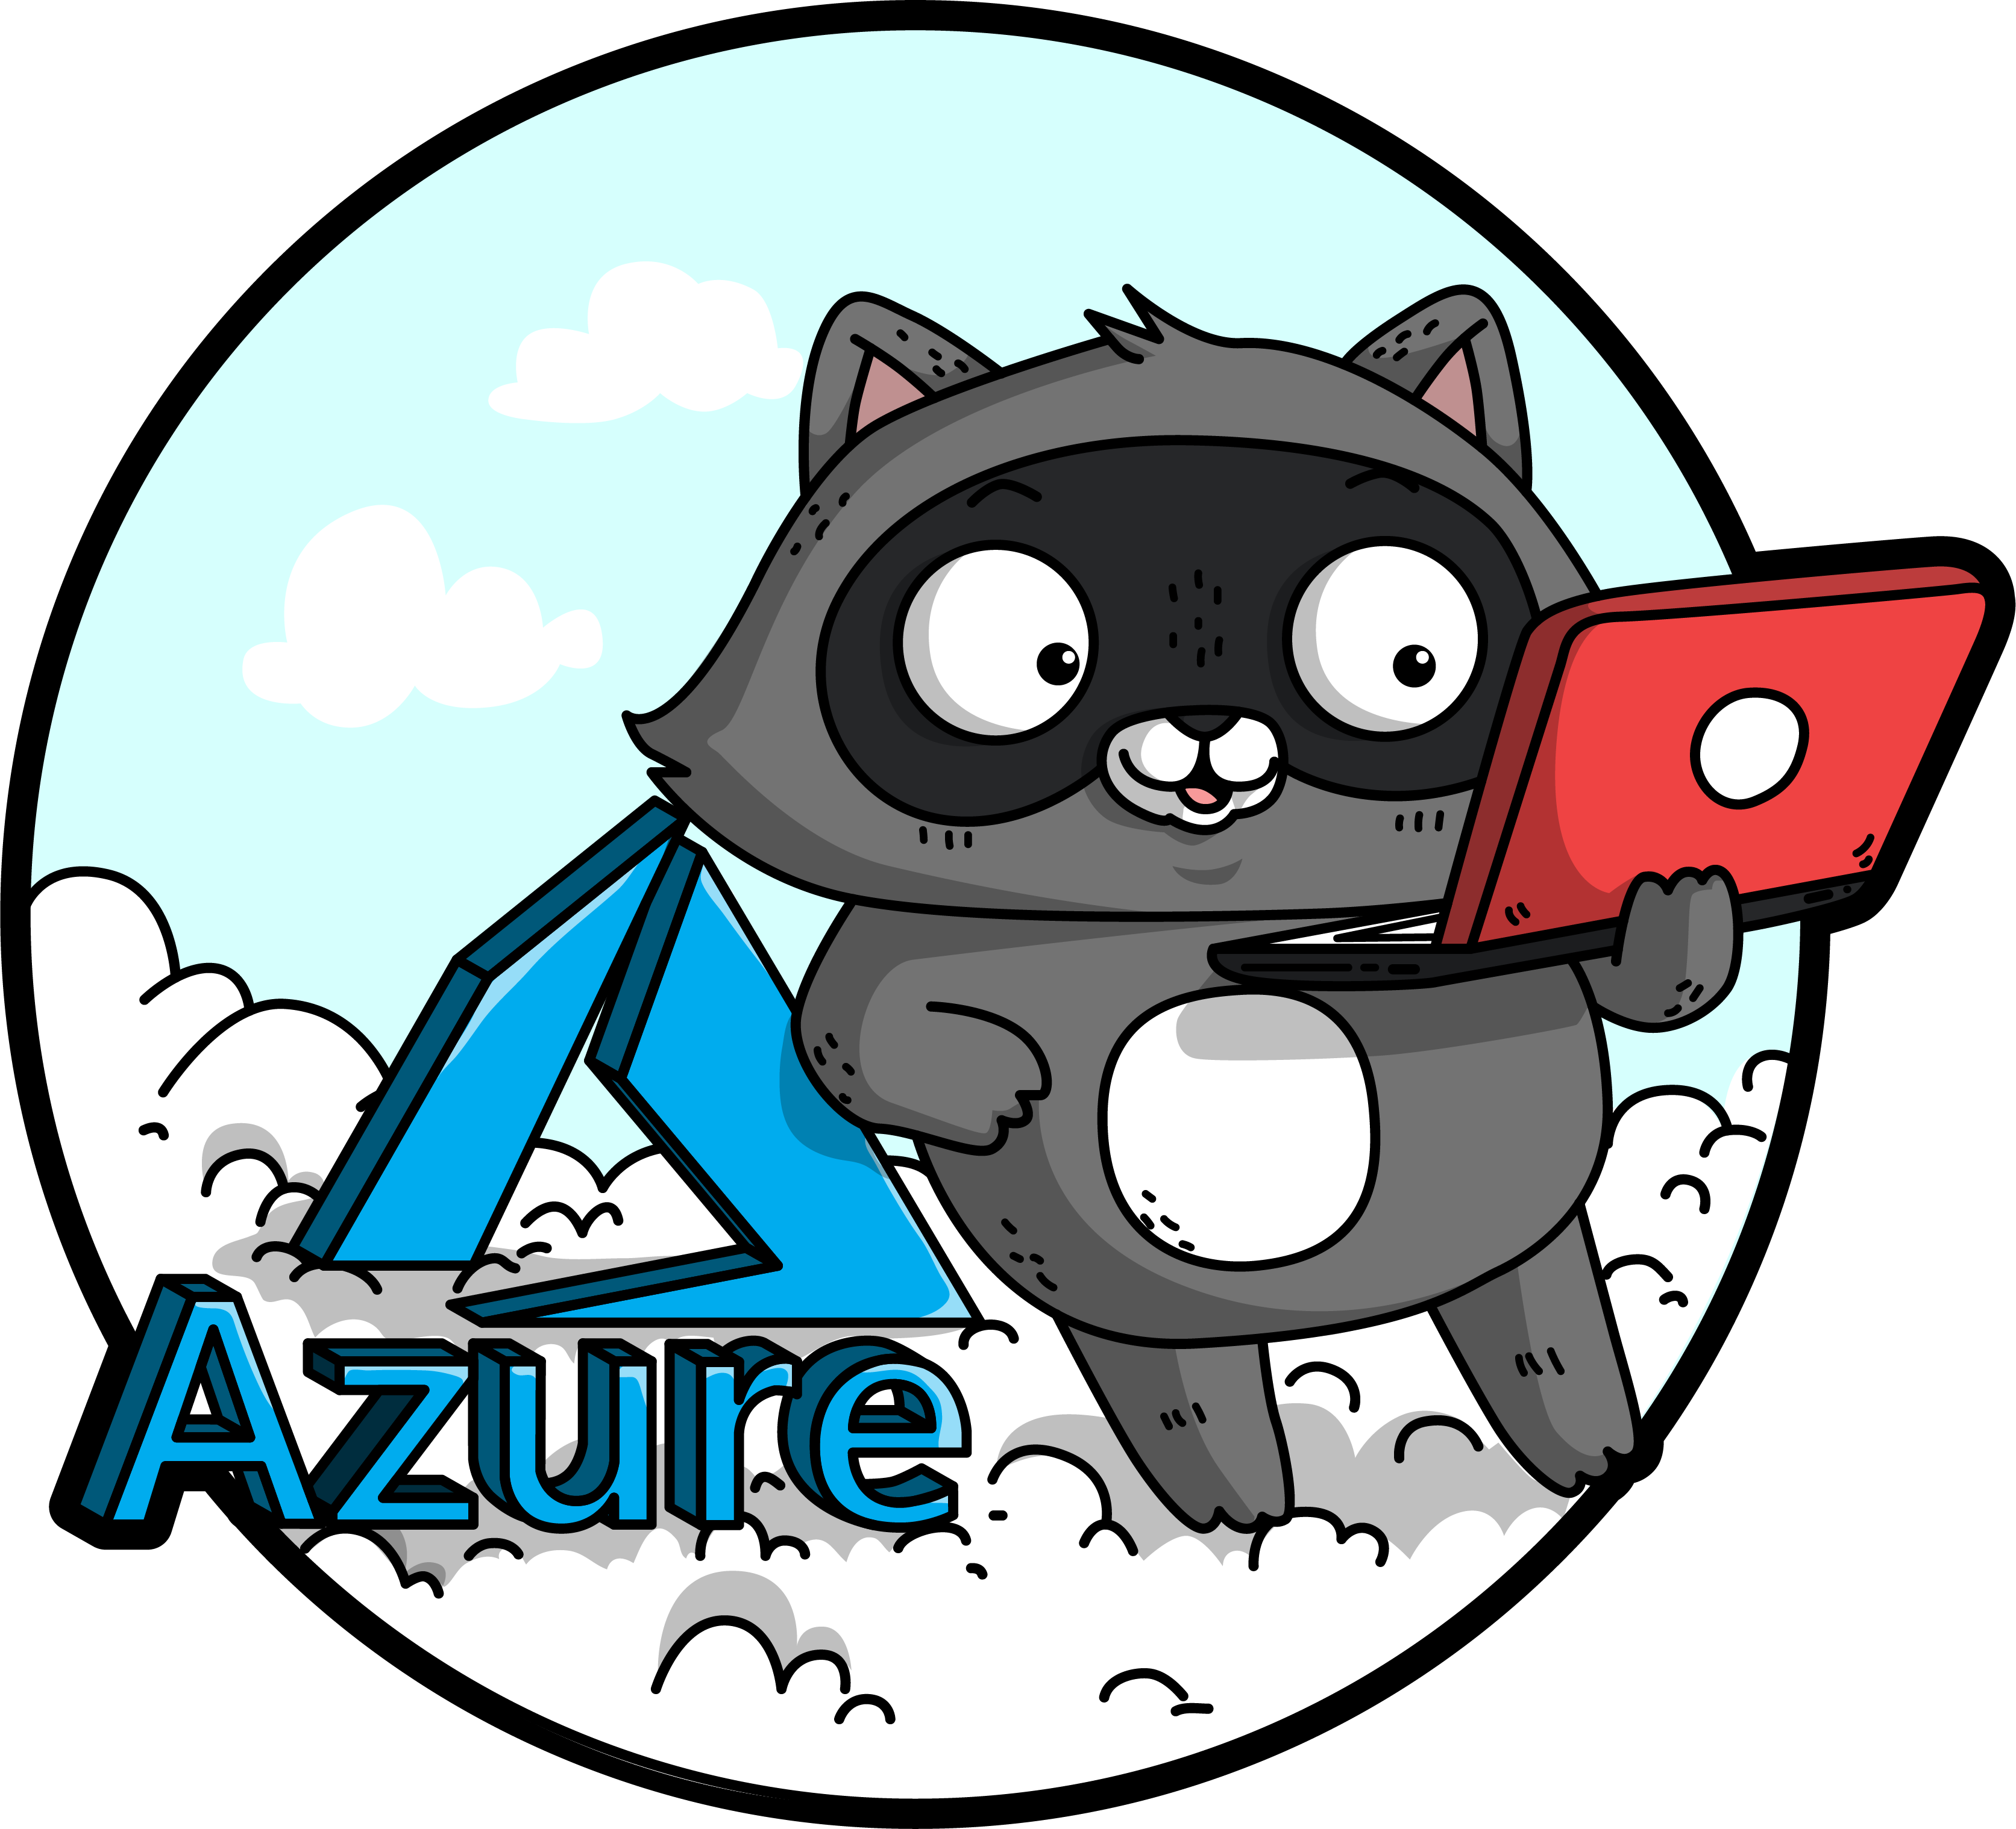
Start your datacentre transformation journey with Azure Migrate
Sarah Lean

Slide 2

Sarah Lean
Cloud Solution Architect
Blogger | Curler | Photographer | Book Lover | Runner | Speaker | STEM Ambassador
13+ years experience in IT
@TechieLass
https://www.techielass.com

Slide 4
Software and hardware refresh
Security threats
Urgent capacity needs
Compliance
Quickly integrate acquisitions
Application innovation
Migration drivers
Software end of support
Datacenter contracts expiry
Notes:
There are a number of reasons that are driving people to look at Azure

Slide 5
Extended security updates for 2008 and 2008 R2 – free in Azure
IaaS: Move to Azure VMs, get 3 more years of extended security updates at no additional charge
PaaS: Move SQL Server to Azure SQL Database Managed Instance (version free, fully managed, no patching needed)
Use Azure Hybrid Benefit to maximize on-premises investments
Migrate to Azure
SQL Server 2008 and 2008 R2
Extended support
ends July 9, 2019
Windows Server 2008 and 2008 R2
Extended support
ends January 14, 2020
Upgrade to current Windows Server/ SQL Server versions
OR
Buy 3 more years of extended security updates on 2008/2008 R2
2018
2019
2020
Stay on-premises

Slide 6
Unified and extensible Azure migration experience
Assess
Migrate
Optimize
Secure and manage
Migration tools | Azure migration center | Scenario guidance | FastTrack for Azure | Azure Expert MSPs
Foundational best practices: People | Process & Planning | Technology

Slide 7





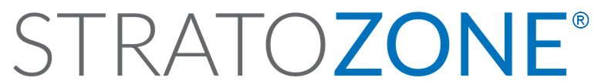


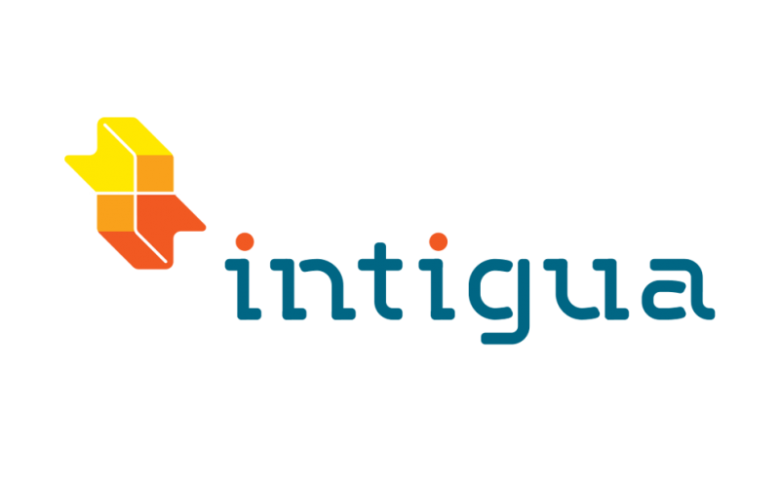







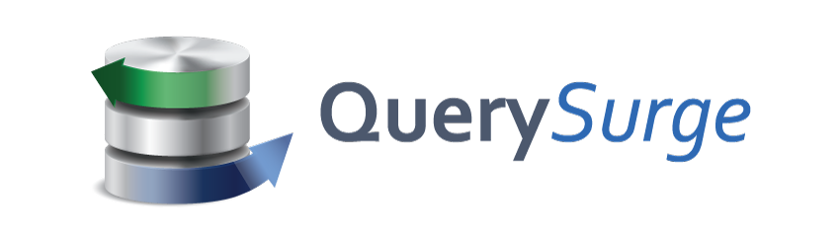
Choice of tools for every stage and every requirement
Goal is successful Azure migration: Pick the right tool for the job
Assess
Migrate
Optimize
Secure & Manage
Azure Migrate
Azure Site Recovery (ASR)
Azure Cost Management
Azure Advisor
Azure Security & Management
(e.g., Blueprint, Security Center, Backup, Monitor)
Data Migration Assistant (DMA)
Azure Database Migration Service
SQL Server Migration Assistant (SSMA)
Azure Data Box
We embrace ISV solutions

Slide 8
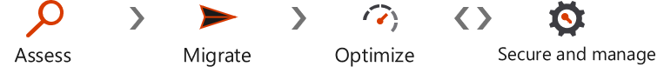
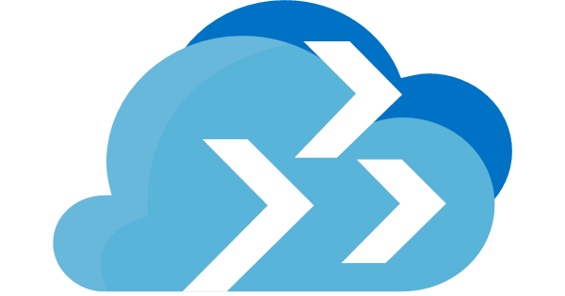
Assess your environments with Azure Migrate
Assess
App performance history
App configuration data
Applicable discounts and offers
(e.g., Azure Hybrid Benefit, RI)
Target Azure location
Azure suitability analysis
(e.g., compatibility)
Rightsized Azure resource model
Azure cost estimates
App dependency map
Azure Migrate
VMware and Hyper-V (NEW!) assessments | Windows and Linux assessments | Free, built in service

Slide 9
Appliance-based
No pre-setting or pre-configuring a machine
No installation of pre-requisite software

Slide 10
Light discovery
No agents to install and no firewall ports to open

Slide 11
Data Collected
Cores
Memory
Disks
Disk Sizes
Network Adapters
CPU usage
Memory usage
Disk IOPS
Disk throughput (MBps)
Network output (MBps)
VM Name
IP Address

Slide 12
Supported Geographies
Geography | Storage location
Azure Government | US Gov Virginia
Asia | Southeast Asia
Europe | North Europe or West Europe
United States | East US or West Central US

Slide 13
Create an Azure Migrate Project

Slide 14
Azure Migrate Appliance Install

Slide 15
Deep discovery
Agent-based
No guesswork anymore
No need to remember which machine belongs to which app

Slide 16
Azure Migrate Agent Install
Notes:
The Microsoft Monitoring Agent service collects events from log files and Windows event log, performance data, and other telemetry. Even when the agent is unable to communicate with the Log Analytics service it reports to, the agent continues to run and queues the collected data on the disk of the monitored computer. When the connection is restored, the Microsoft Monitoring Agent service sends collected data to the service.
Dependency Agent - Service Map shows connections between servers, processes, and ports across any TCP-connected architecture with no configuration required, other than installation of an agent.

Slide 17
Service Map
Presents a view of your servers as you think of them – as interconnected systems
Discovers and maps server and process dependencies in real-time
Can monitor cloud and on premises servers

Slide 18
Service Map

Slide 19
Use
Helps understand dependencies
Doesn’t just need to be used when migrating

Slide 20
Migration Assessment
Three stages
Suitability Analysis
Sizing
Monthly Cost estimation

Slide 21
Azure Migrate Assessment

Slide 22
Foundational best practices for Azure migration
People
Planning & process
Technology
Drive org culture change
Set up migration center of excellence (CoE)
Ensure right stakeholders are engaged
Provide learning paths & certifications
Use skilled migration partners
Build biz case w/ exec sponsorship
Plan migration strategies
Start small: Do a pilot
Track migration scorecard
Track and optimize cloud spends
Choose the right tools for the job
Govern Azure environments & resources
Extend networking/identity to Azure
Establish robust security foundation
Use integrated security/management tools

Slide 23
Best practices by phase
Best Practice
Learnings from at-scale Azure migrations
Assess
Migrate
Optimize
Secure & Manage
Build an Inventory of apps, databases, & VMs
Update or create service catalog with the Business, and beware departmental apps, databases & reports
Look for good POC candidates
Assign priority, complexity & risk to all items which will be migrated to Azure
Beware of higher security apps and those which integrate with firewalls
“Redesign” every app for Azure!
Choose the right tool for the job, and be flexible
Select more powerful sizes of Azure resources during the migration and scale down (saves time during migrations)
Involve the Business at every step, identify a contact for each group and demand testers and sign-off (no Monday madness)
Perform non-disruptive testing and performance testing prior to cutovers
Start with Easy, then move on to the hard
Azure Cost Management is a critical tool
Leverage Azure Hybrid Use Benefit for Windows and SQL along with Reserved Instances to save up to 80%
Scripts and Azure Automation should be used to shutdown VMs that aren’t needed 24x7
Watch out for migration left overs like onetime backups sitting in Blob Storage or VHDs and Snapshots that aren’t being used
Migration isn’t complete until it is fully operatized without monitoring, backup, failover and security configured
Partner solutions can be extended to the cloud if you use a third party backup, it will most likely work with Azure
Leverage Azure Automation or tools like Terraform, Chef & Ansible
Leverage Platform tools such as Azure Security Center, Log Analytics and Application Insights

Slide 24
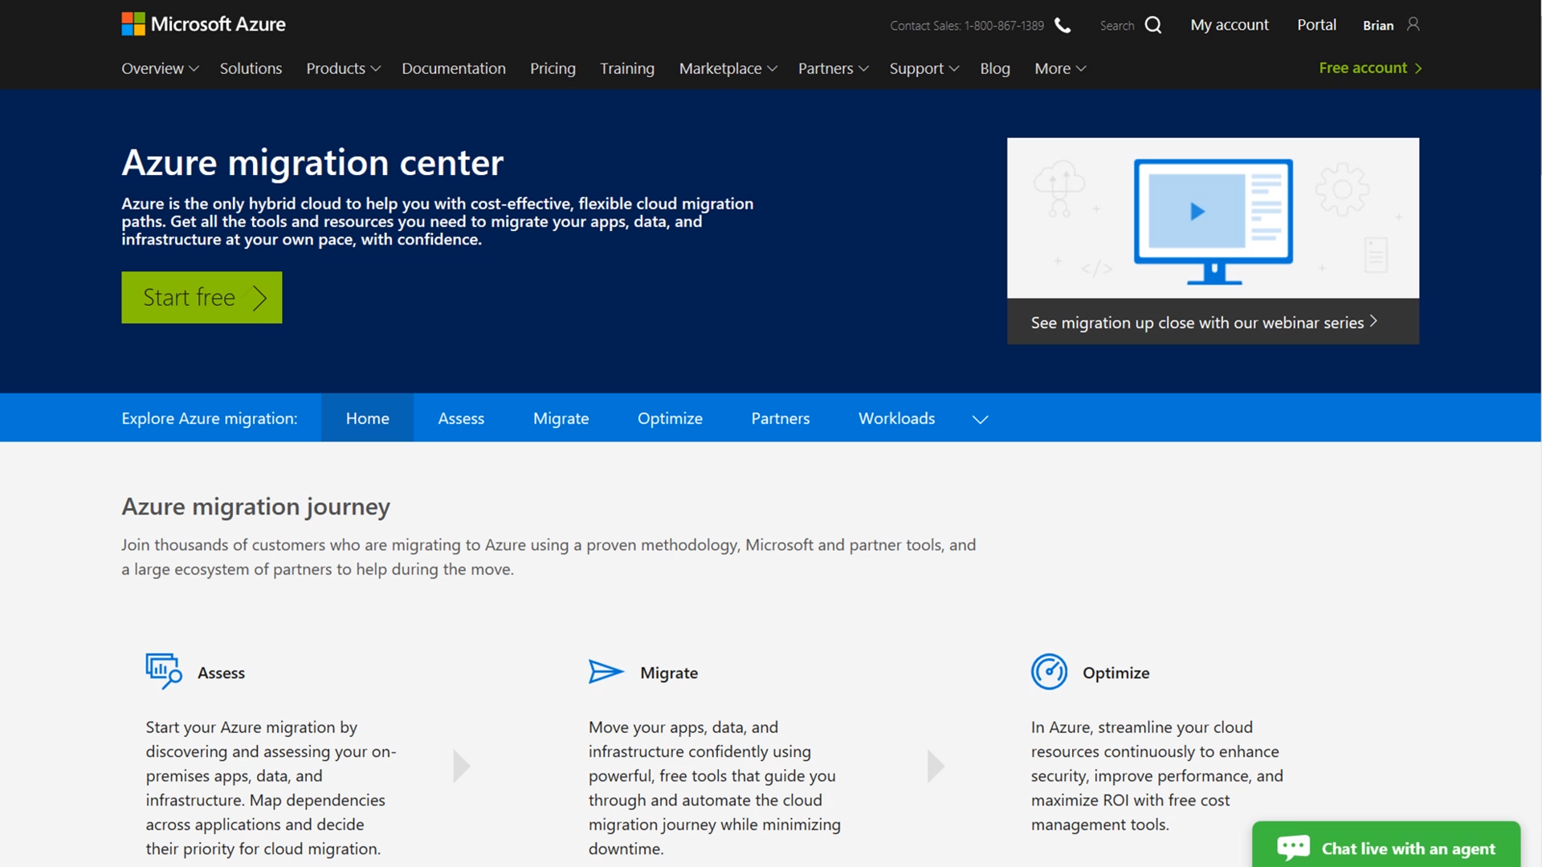
Azure migration center All things migration
Guidance
Tools
Partners
Migration journey and strategies
Right tools for the job
Migration experts
Azure.com/Migration

Slide 25
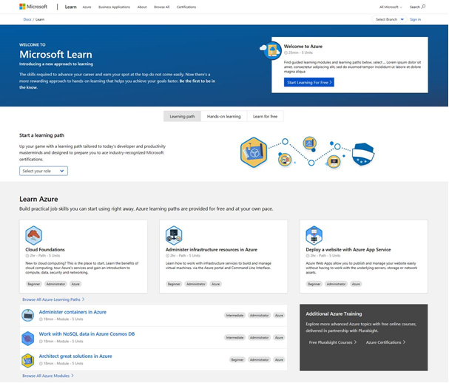
Keep up to date on your Azure skills as you migrate
Announcing free migration course Assessing and Planning Azure Migration
Microsoft.com/Learn
Build skills quickly
Measure Azure skill proficiency
Role based certification & training

Slide 26

https://aka.ms/sarahfeedback
Thank you | Q&A
@TechieLass

